Slide 1
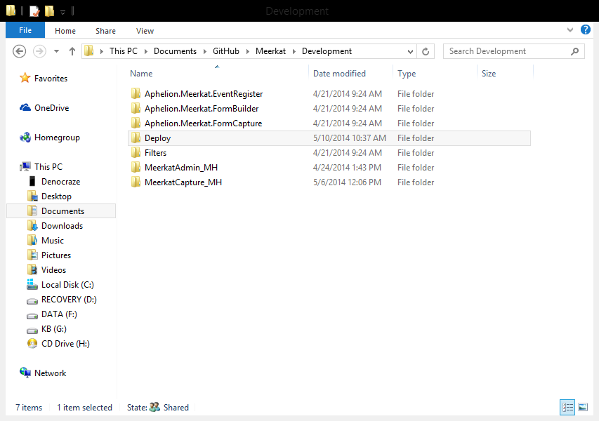
Open the Development folder under Meerkat in the Github repository and copy the deploy folder.

Slide 2
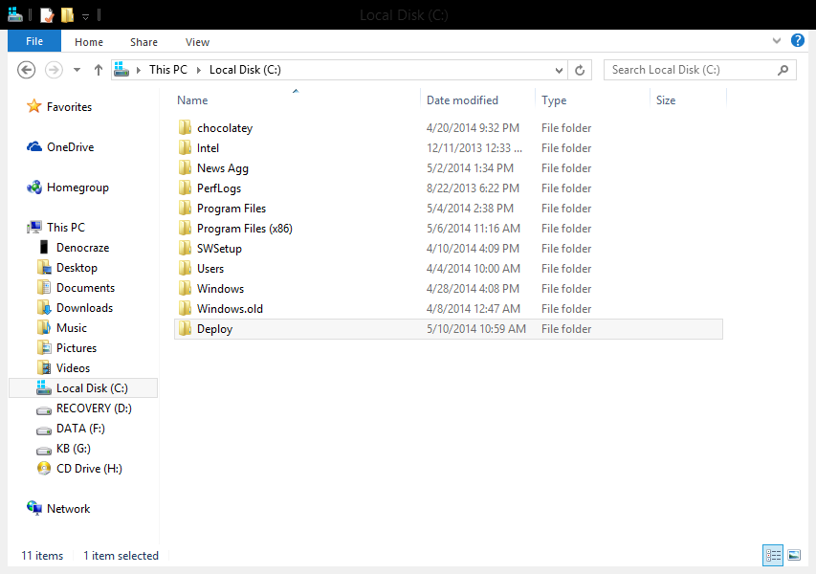
Paste to local drive C and

Slide 3
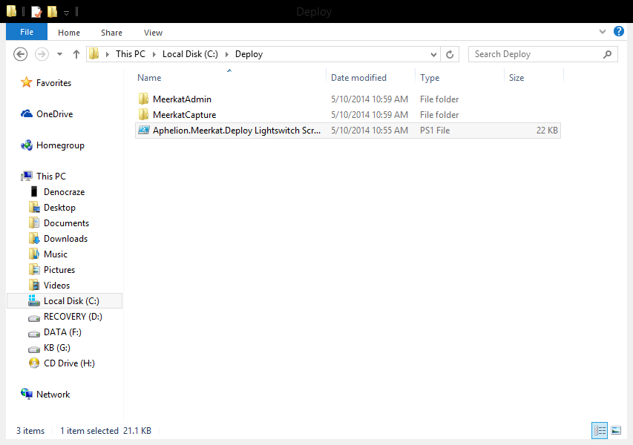
Open the folder and run the script in it.

Slide 4
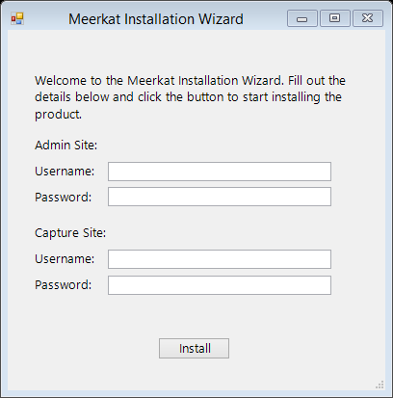
Fill out the username and password that has access to both SharePoint and the database. Use the same username and password combination. Once you’re done, click install.

